Slide 1



Setiembre 2024
“Era de Revoluciones”
Oportunidades y Desafíos
De la Minería Peruana en la
Transición Energética
Jose E. Gonzales

Slide 2


Indice
Mercados
Postpandemia
America Latina
Descarbonización
Amazonia
Perspectivas

Slide 3
Mercados

Slide 4
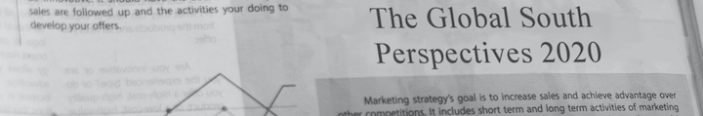
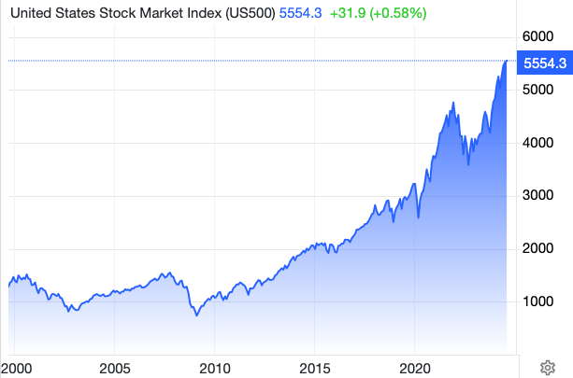
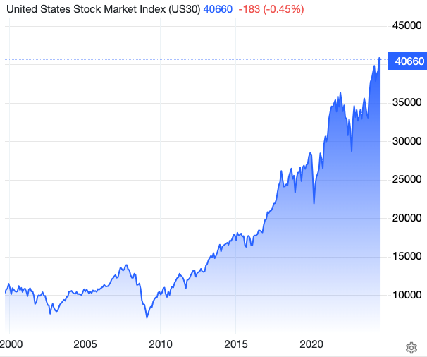
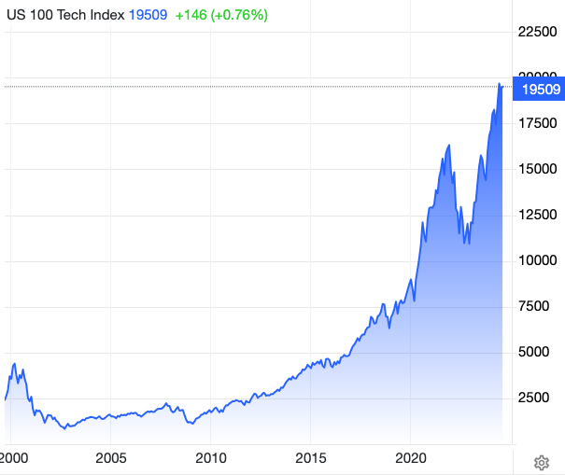

GCC Advisors
Acciones
Source: Trading Economics

Slide 5
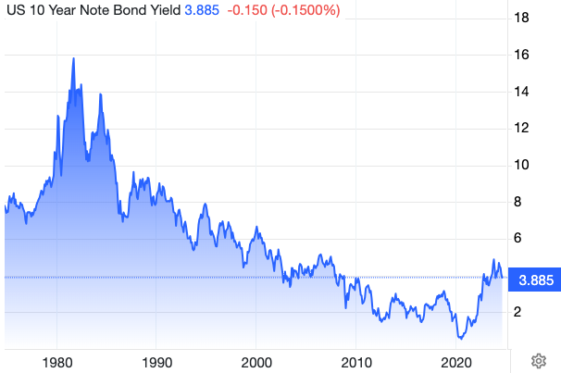
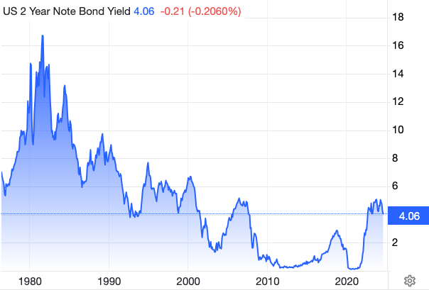
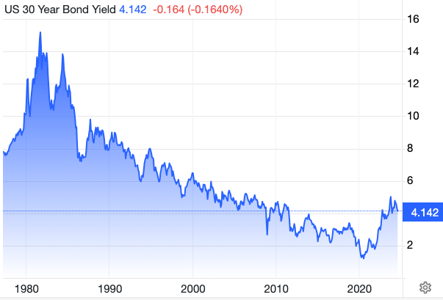
GCC Advisors
Bonos
Source: Trading Economics

Slide 6
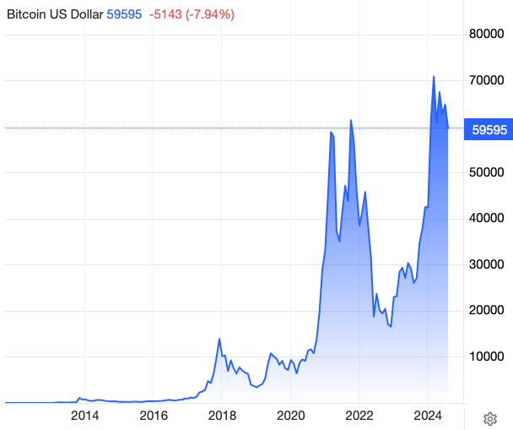
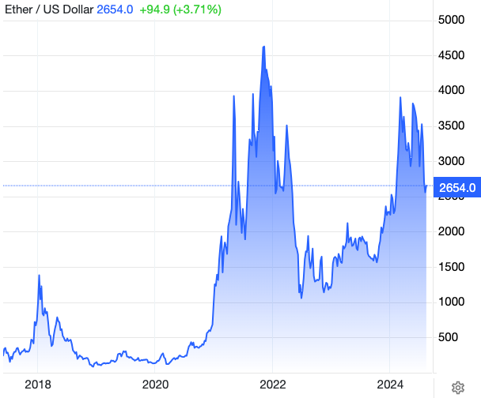
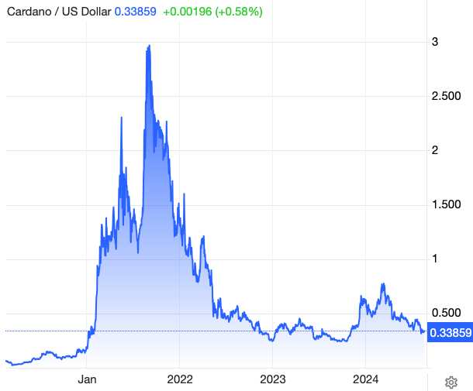
GCC Advisors
Cryptos
Source: Trading Economics

Slide 7
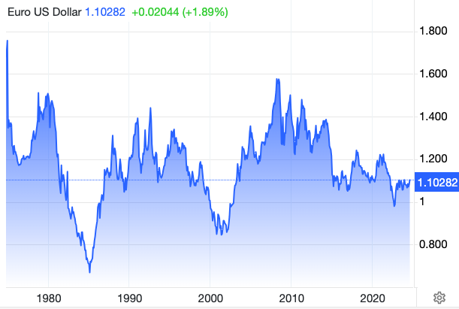
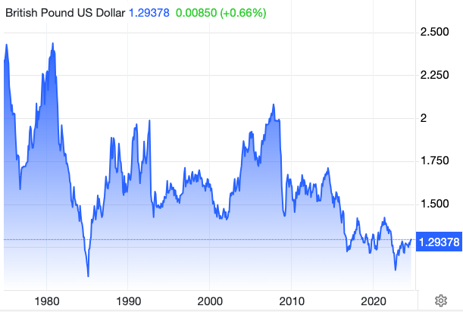
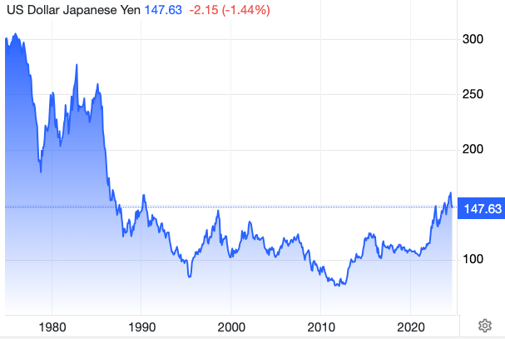
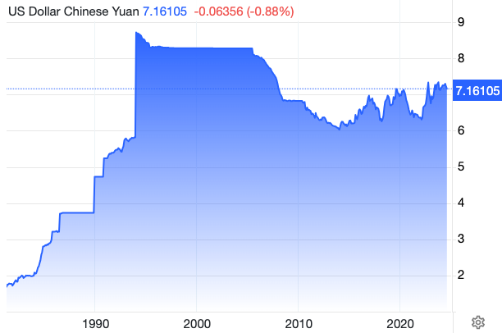
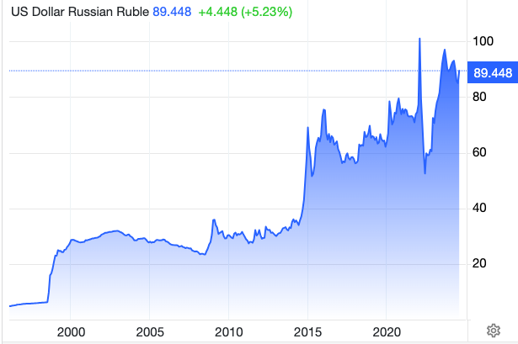
GCC Advisors
FX
Source: Trading Economics

Slide 8
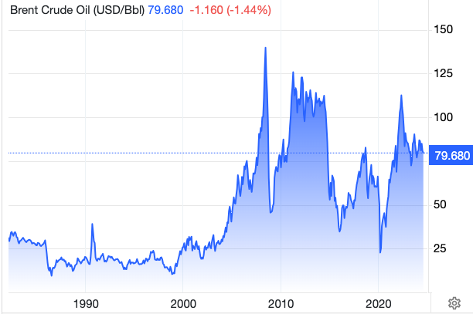
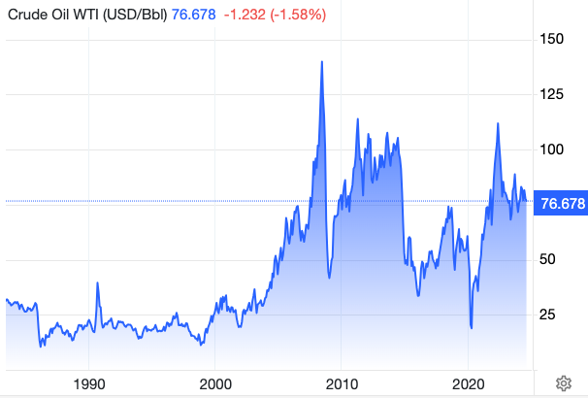
GCC Advisors
Petroleó
Source: Trading Economics

Slide 9
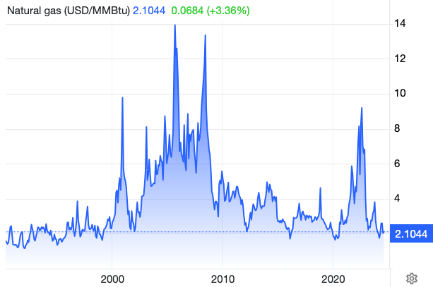
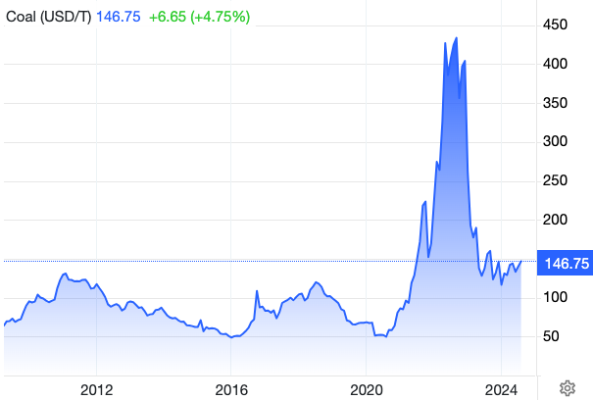
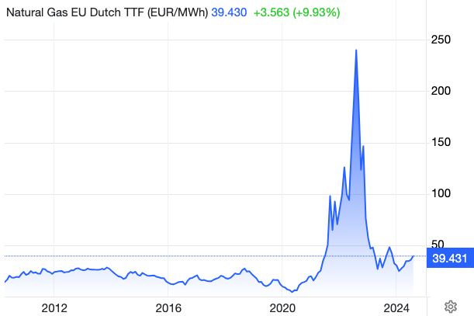
GCC Advisors
Gas | Carbón
Source: Trading Economics

Slide 10
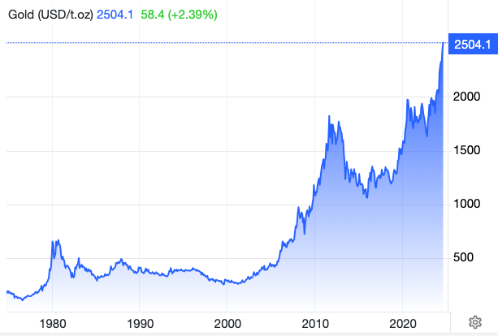
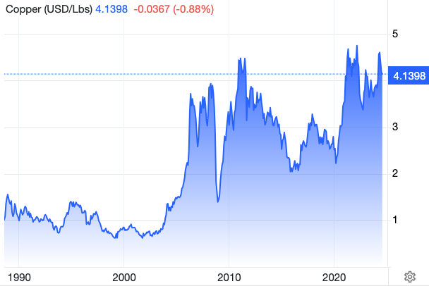
GCC Advisors
Oro | Cobre
Source: Trading Economics

Slide 11
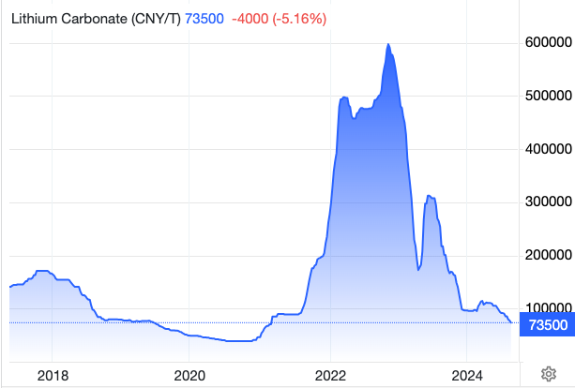
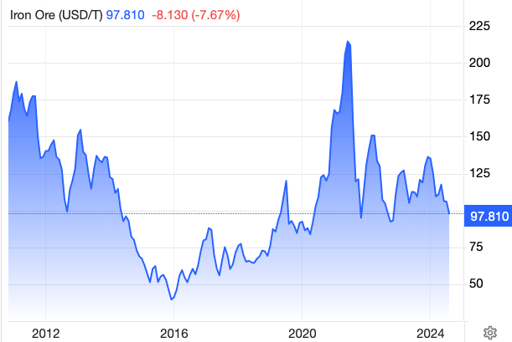
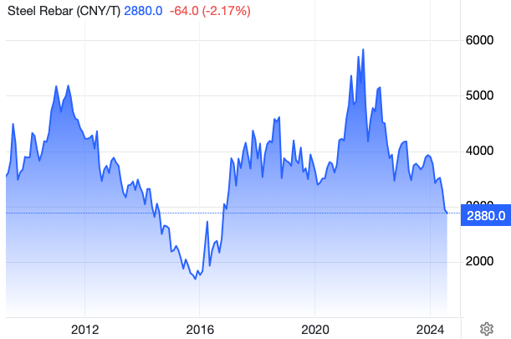
GCC Advisors
Litio | Hierro | Acero
Source: Trading Economics

Slide 12
Postpandemia

Slide 13
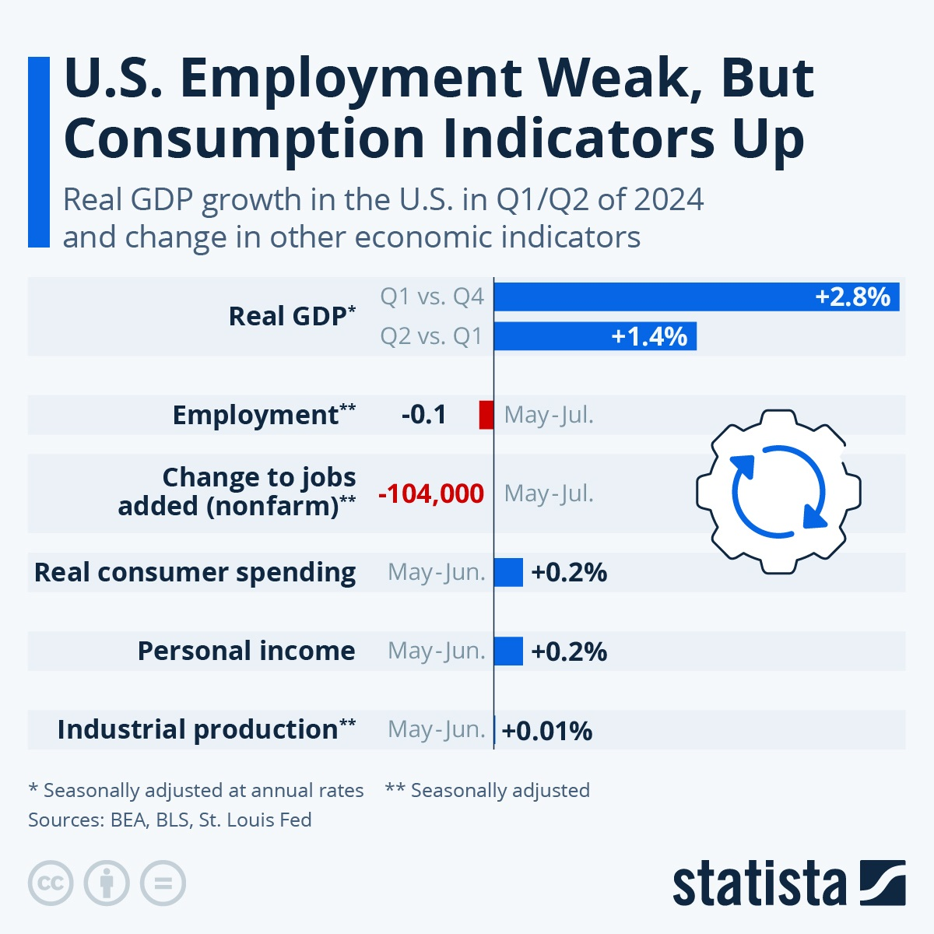
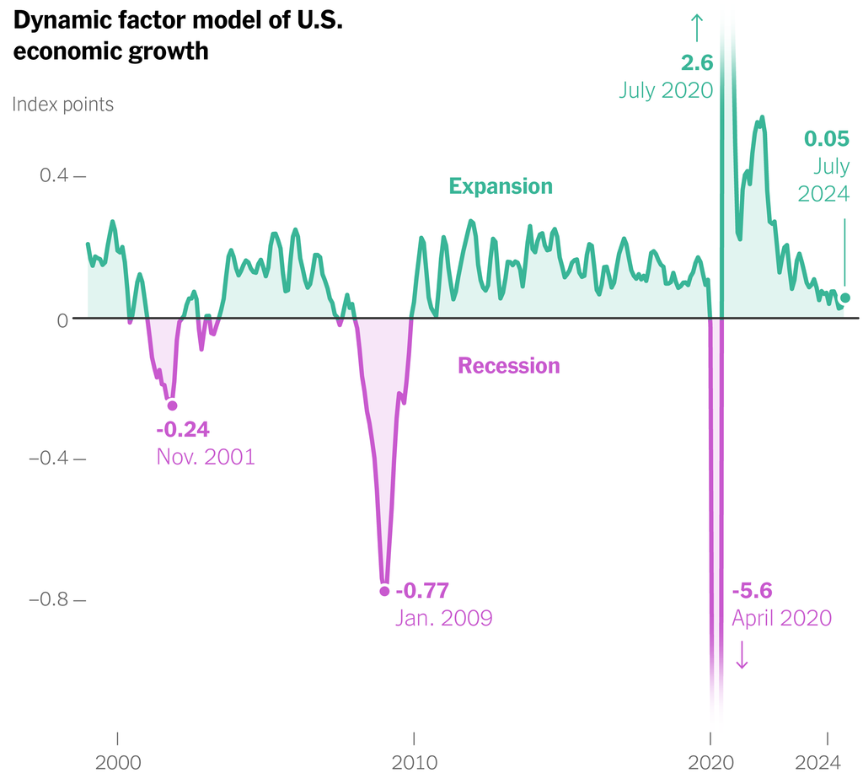
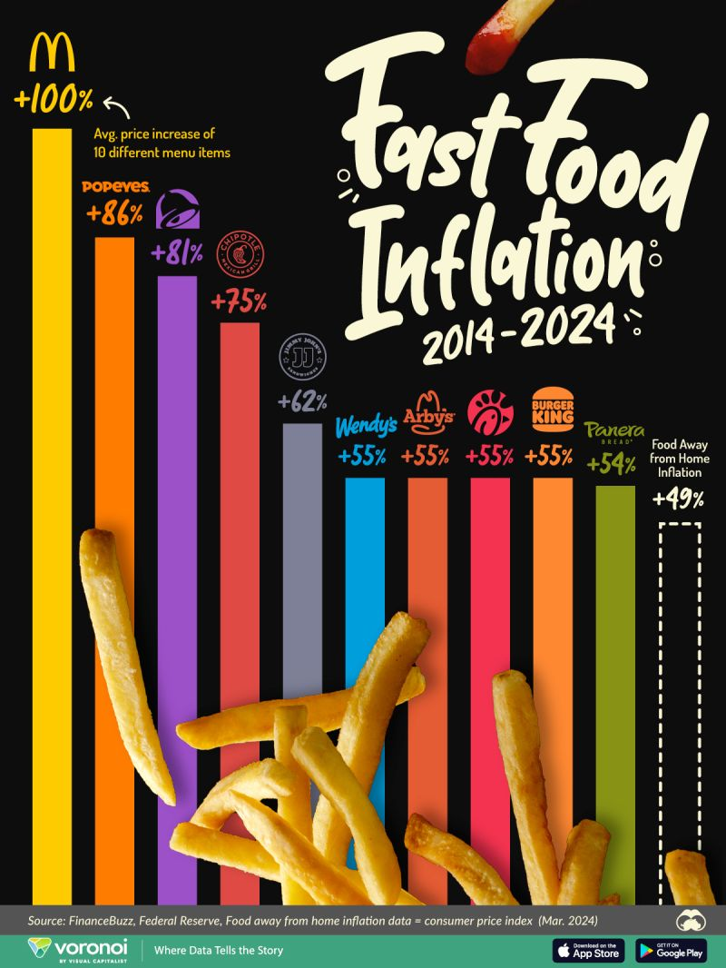
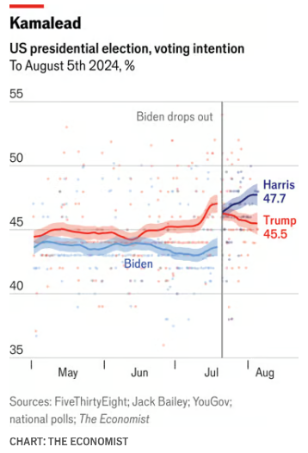
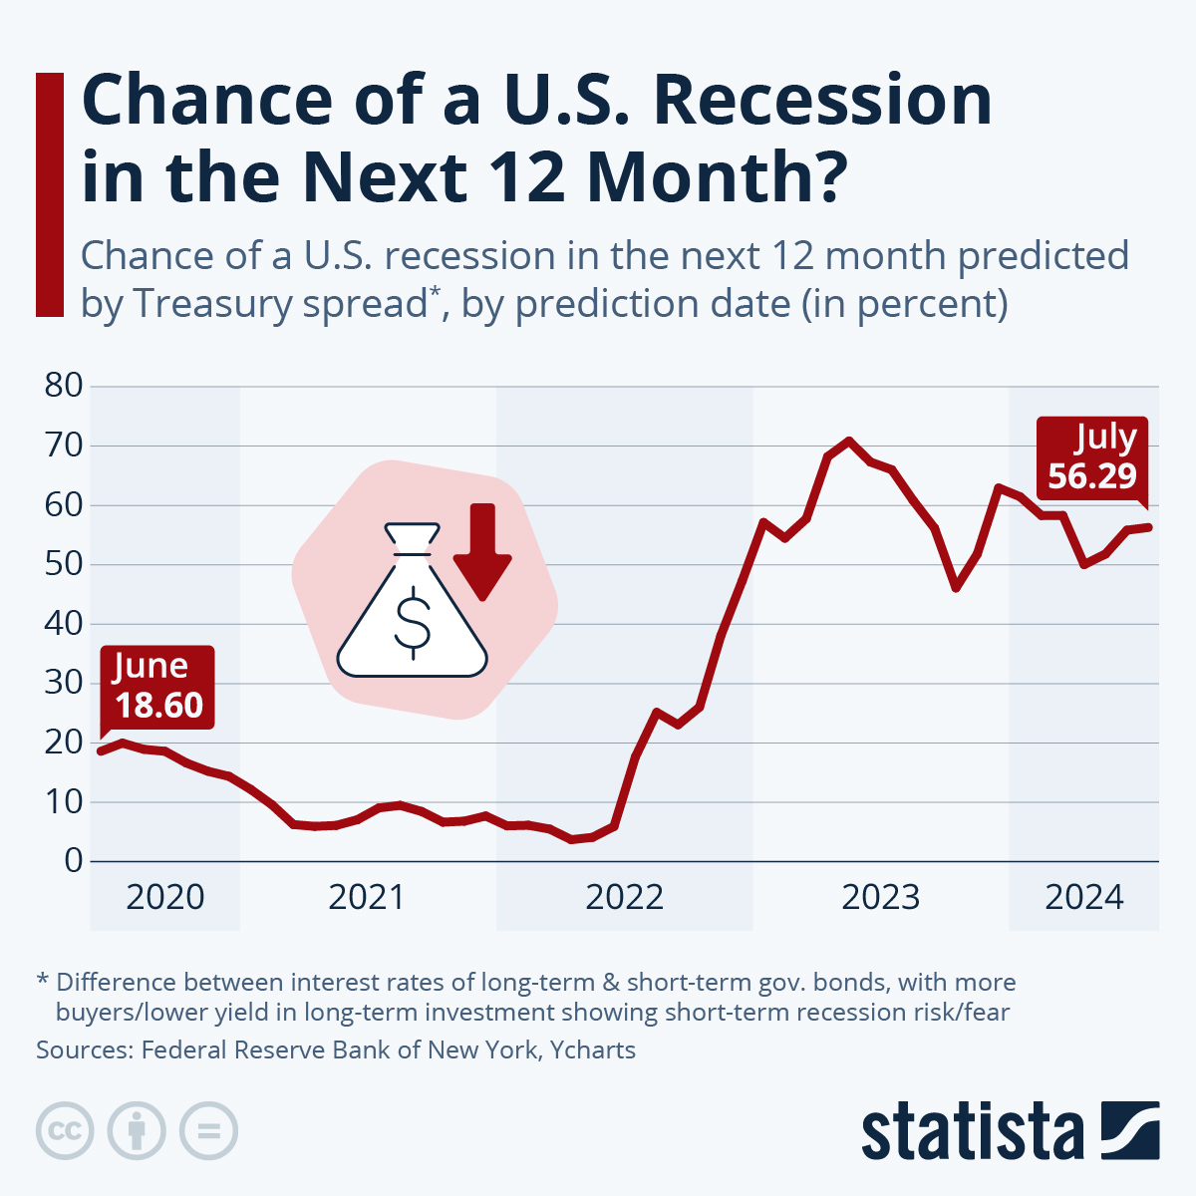
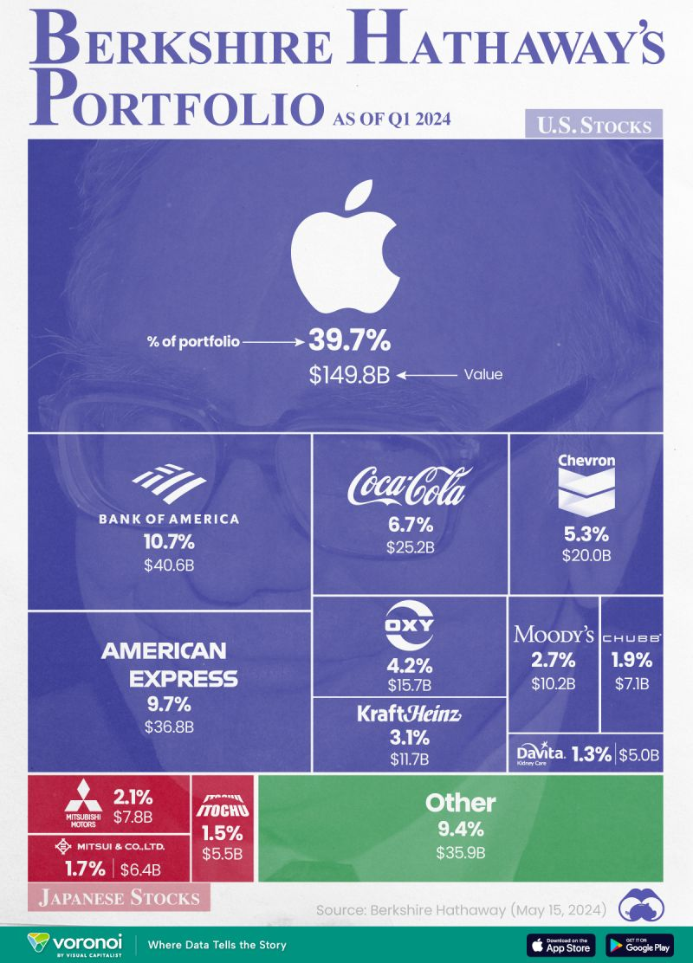
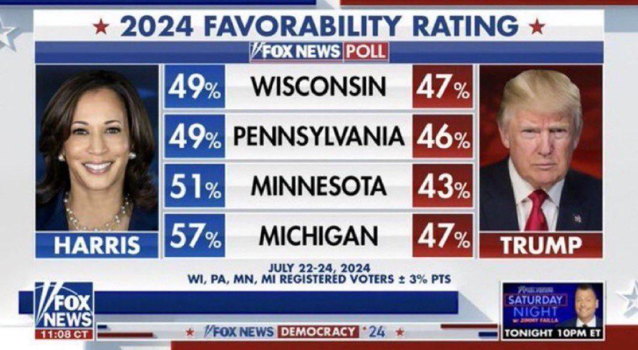
GCC Advisors
“Mesoeconomía”
Source: Statista, Boronoi, Fox News, The Economist

Slide 14
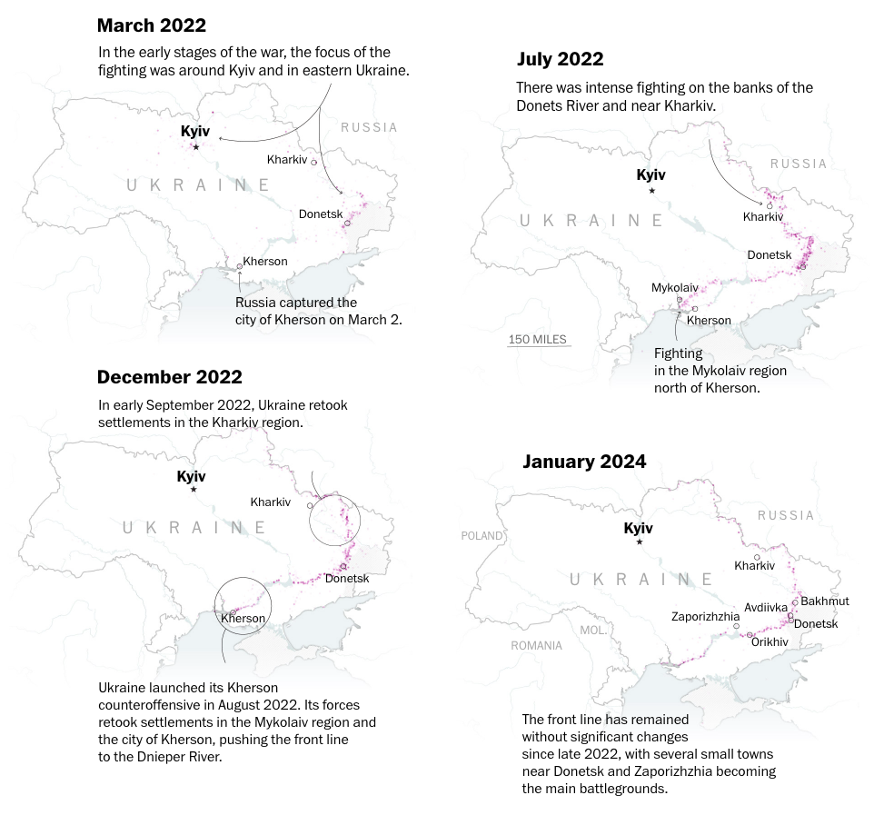
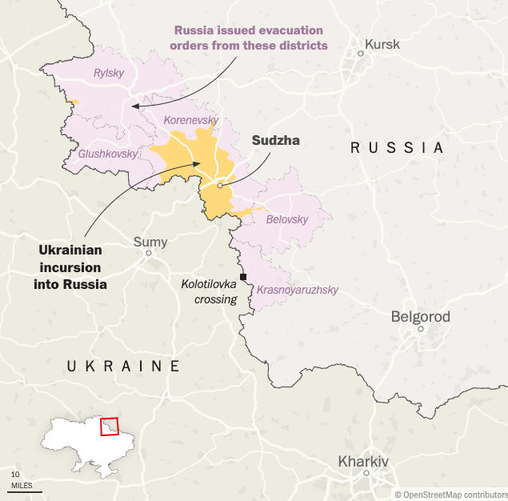
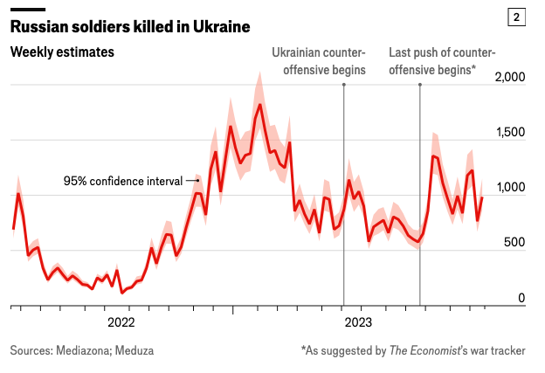
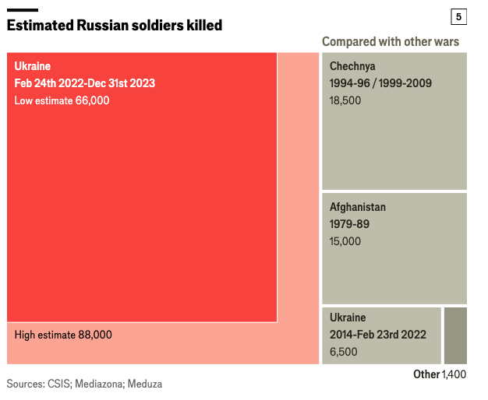
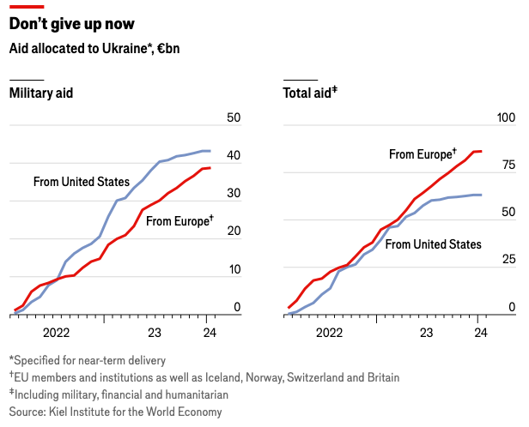
GCC Advisors
Ucrania
Source: New York Times, The Economist, ACLED

Slide 15
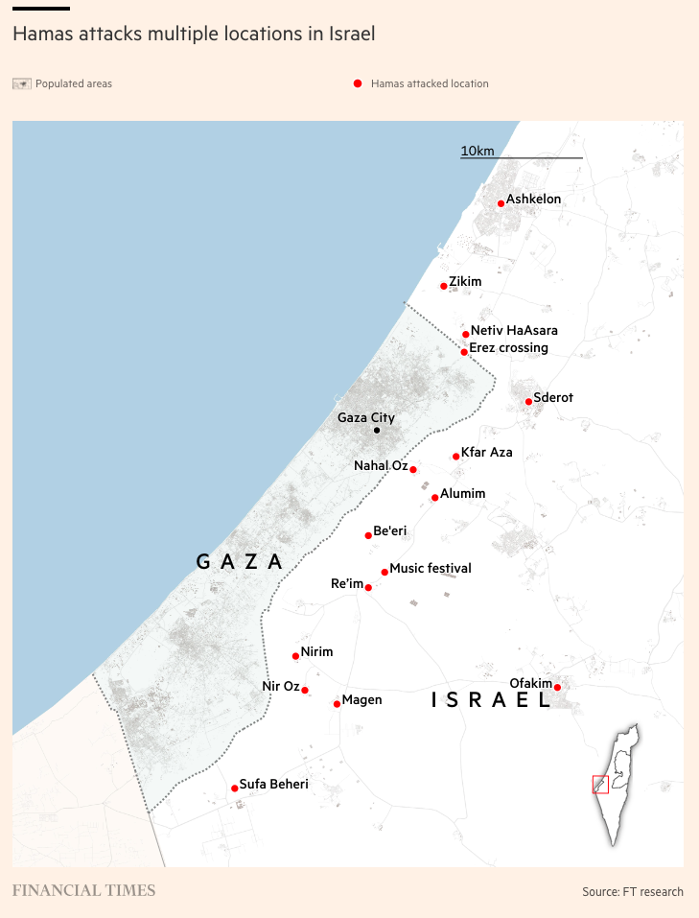
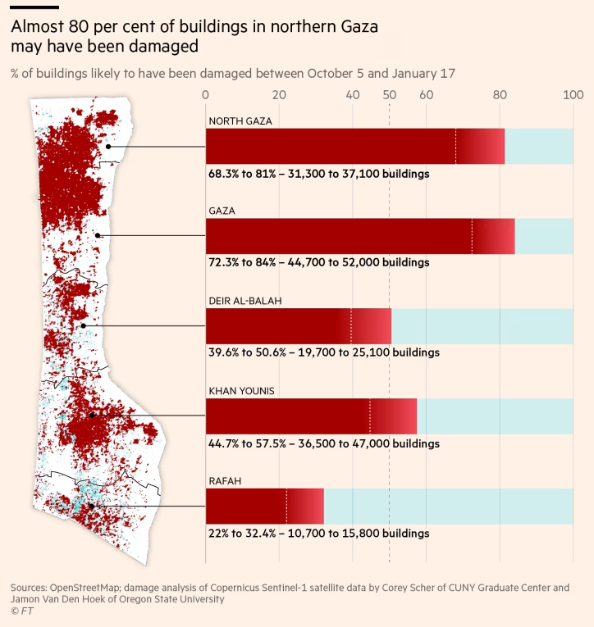
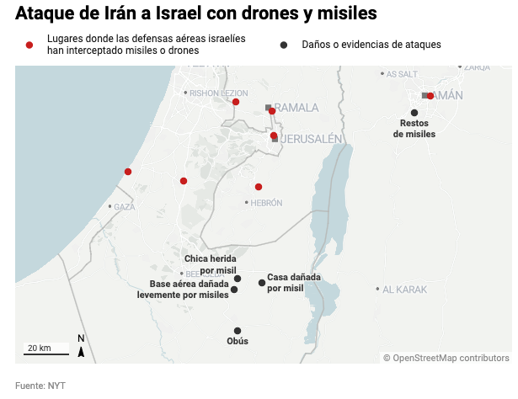
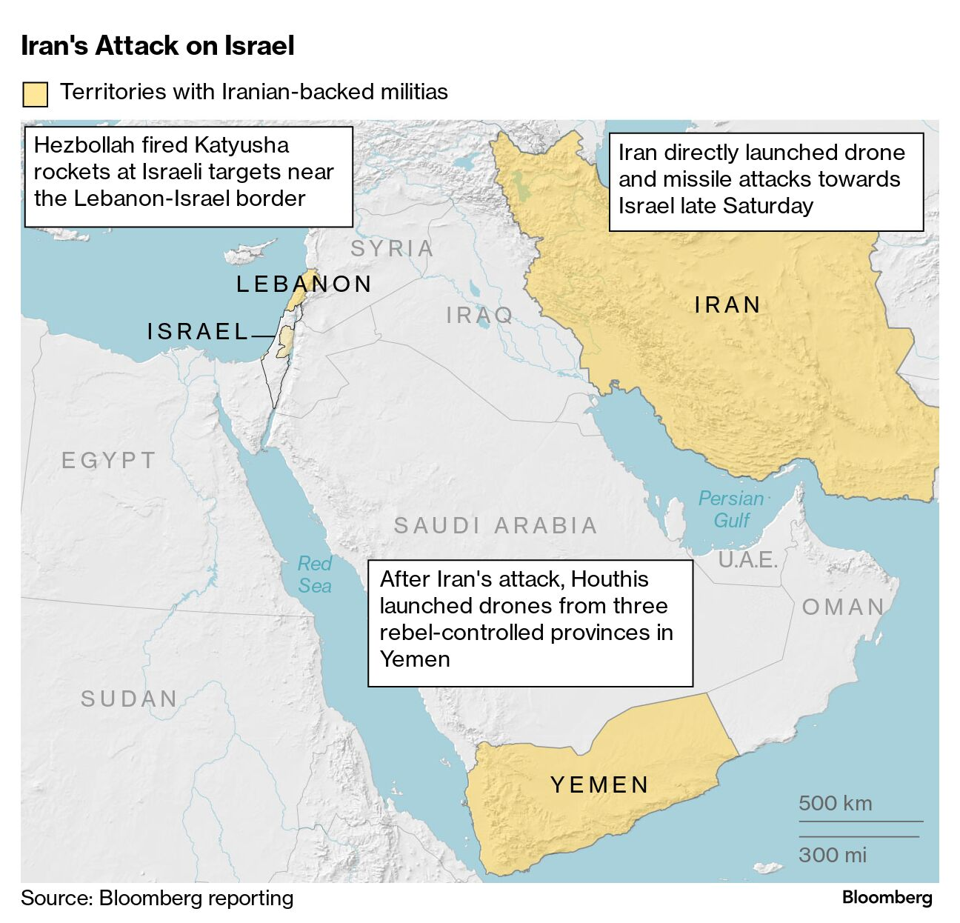
GCC Advisors
“Israel en Guerra”
Source: Financial Times, New York Times, Bloomberg

Slide 16
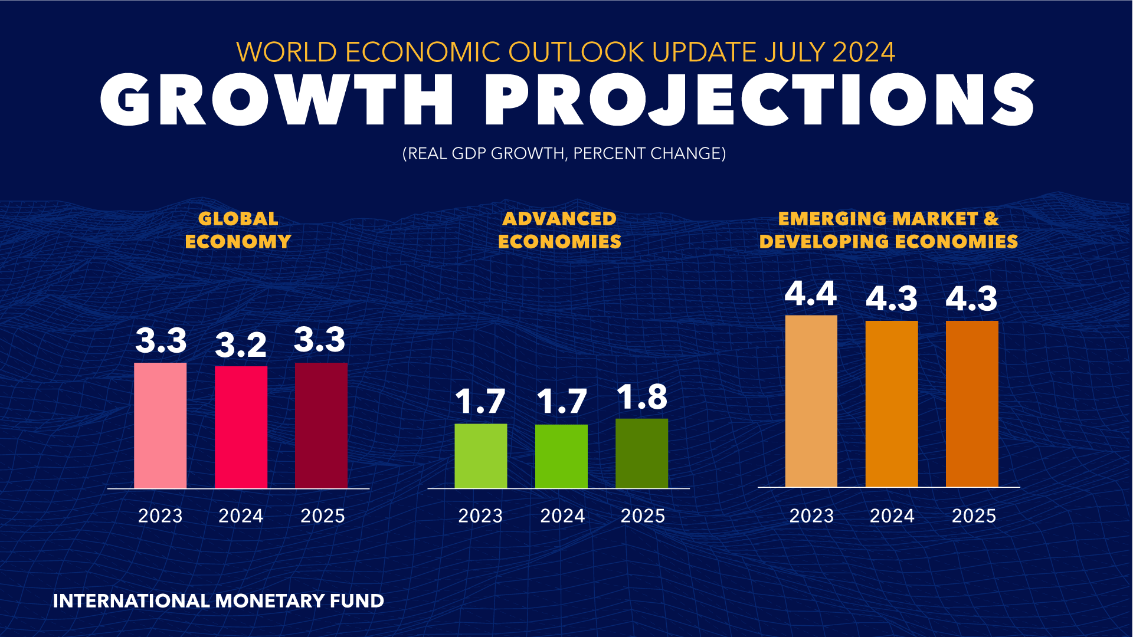
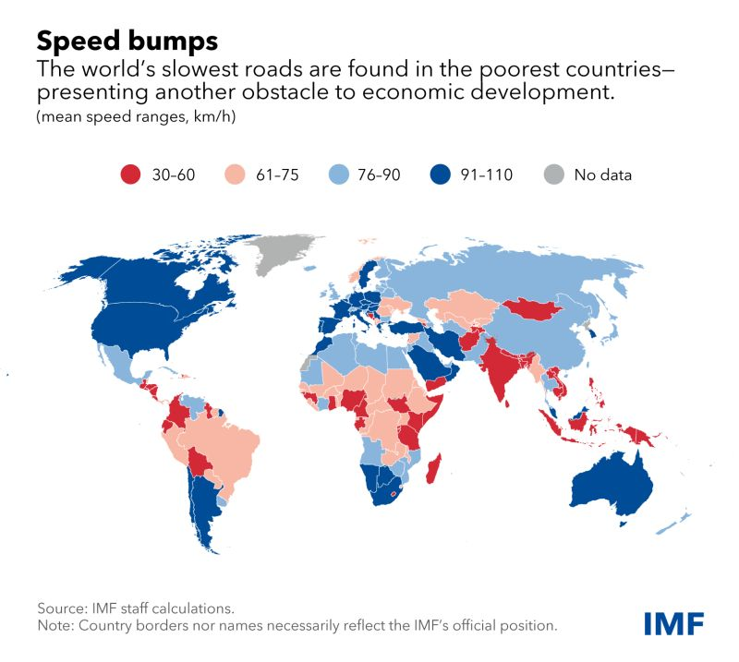
GCC Advisors
“Sticky Spot”
Source: IMF WEO July 2024

Slide 17
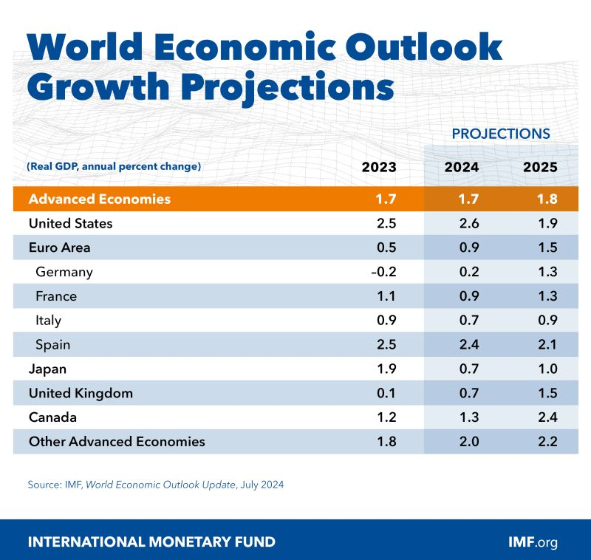
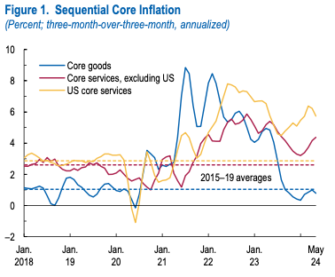
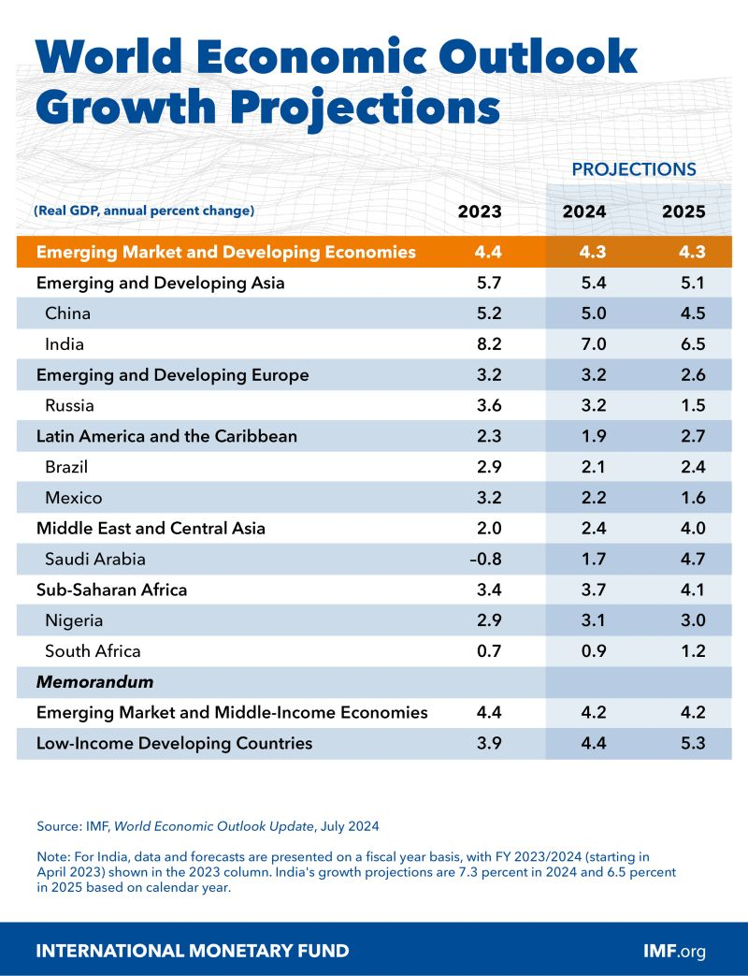
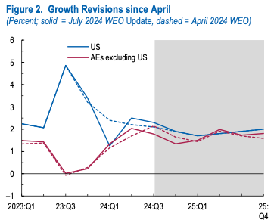
GCC Advisors
“Persistent Services Inflation”
Source: IMF WEO July 2024

Slide 18
America Latina

Slide 19
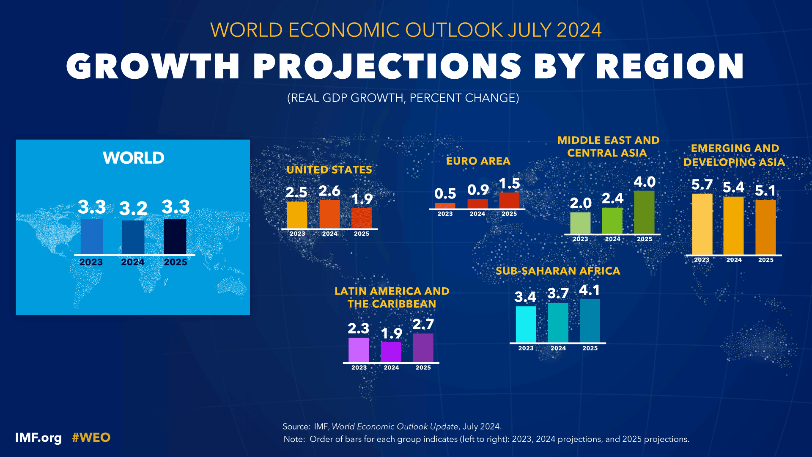
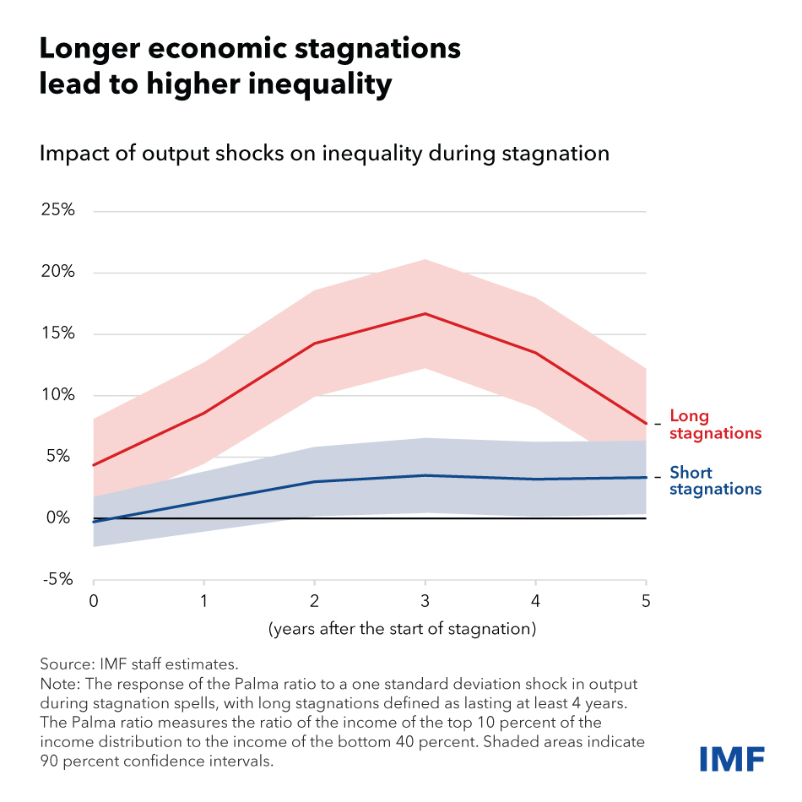
GCC Advisors
America Latina I
Source: IMF WEO July 2024

Slide 20
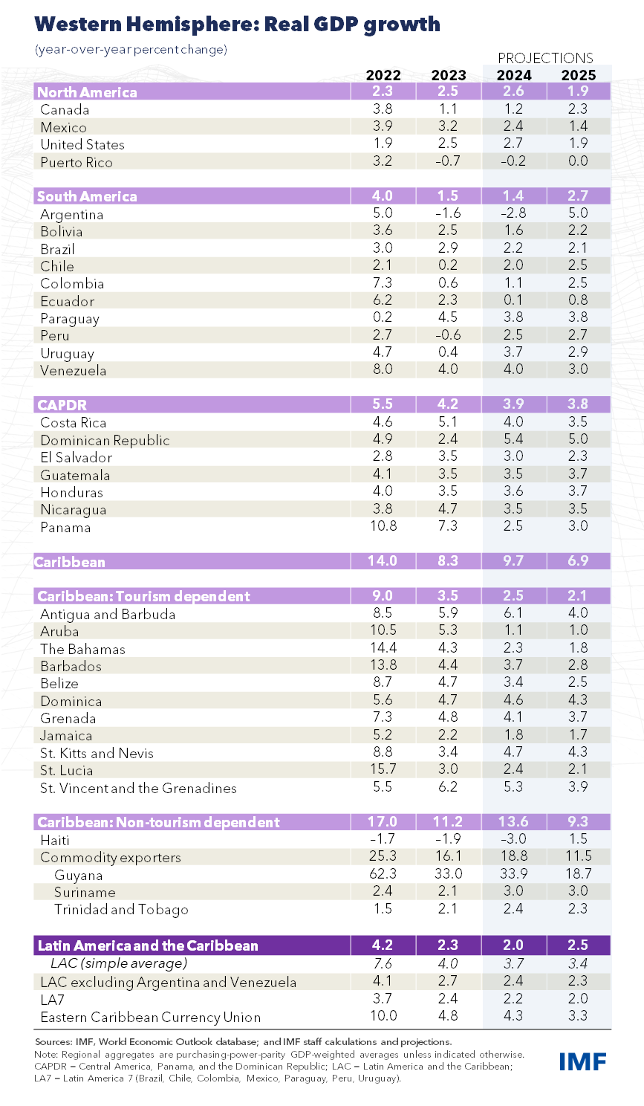

GCC Advisors
America Latina II
Source: IMF WEO April 2024

Slide 21










GCC Advisors
America Latina III
Source: Latinometrics

Slide 22
Descarbonización

Slide 23




GCC Advisors
Energía
Source: Elements

Slide 24



GCC Advisors
Emisiones
Source: Elements, Visual Capitalist

Slide 25









GCC Advisors
Calentamiento Global
Source: Visual Capitalist, Climate Reanalyzer, Quartz, Bloomberg, Berkeley Earth Land

Slide 26






GCC Advisors
Descarbonización
Source: FT, UNEP, Wood Mackenzie, UNF, Casem Cevre

Slide 27




GCC Advisors
Electromovilidad
Source:: Visual Capitalist, Elements, GS

Slide 28






GCC Advisors
Transición Energética
Source: Elements, Visual Capitalist, IEA, Wood Mackenzie, McKinsey GI

Slide 29




GCC Advisors
Minerales Críticos
Source: Elements, Teck, Energy Minute

Slide 30
Amazonía

Slide 31


GCC Advisors
Seguridad Alimentaria – Producción
Source: Visual Capitalist, Brazil Potash

Slide 32


GCC Advisors
Seguridad Alimentaria - Precios
Source: Visual Capitalist, Brazil Potash

Slide 33






GCC Advisors
Seguridad Alimentaria - Fertilizantes
Source: Visual Capitalist, Brazil Potash

Slide 34



GCC Advisors
La Amazonía
Source: Visual Capitalist, Brazil Potash

Slide 35
Perspectivas

Slide 36




GCC Advisors
Economía
Source: Visual Capitalist,

Slide 37








GCC Advisors
Energía
Source: Elements, Statista, Bloomberg, Time, ICN, OFP

Slide 38







GCC Advisors
Minería
Source: Visual Capitalist, UN, Bloomberg, GS

Slide 39





GCC Advisors
Naturaleza – Consumo/Deforestación
Source: Voronoi, Resourcetrade.earth, FAO, Carbon Streaming, Visual Capitalist

Slide 40



GCC Advisors
Naturaleza – Agua/CO2
Source: Voronoi, Visual Capitalist

Slide 41






GCC Advisors
Naturaleza - Financiamiento
Source: Nossadata, Forbes, IMF

Slide 42








GCC Advisors
Tecnología
Source: Visual Capitalist, McKinsey, GS

Slide 43







GCC Advisors
Demografía
Source: The New York Times

Slide 44












GCC Advisors
Geopolítica – Estados Unidos
Source: Visual Capitalist, Yahoo Finance, FT, GZERO

Slide 45










GCC Advisors
Geopolítica - China
Source: Substack, The Economist, IMF, Bloomberg, Visual Capitalist

Slide 46







GCC Advisors
Geopolítica - Ucrania
Source: The New York Times, GZERO, Elements

Slide 47








GCC Advisors
Geopolítica - Israel
Source: Visual Capitalist, FT, Bloomberg, Dow Jones, The New York Times

Slide 48







GCC Advisors
Geopolítica – Africa
Source: BBC, Statista, EIU, Visual Capitalist, Global Post

Slide 49





GCC Advisors
Multipolaridad
Source: Visual Capitalist, IMF, Plotset

Slide 50



GCC Advisors
Siglo XXI
Source: Visual Capitalist

Slide 51


